Slide 1
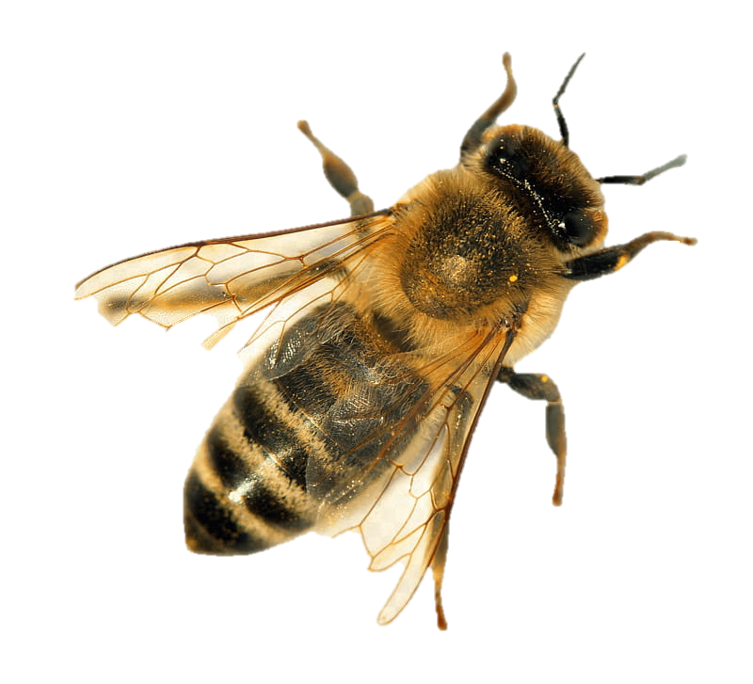

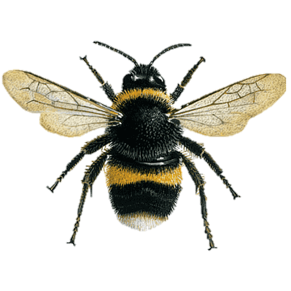
Bees Project
Logan Morrill
Notes:
This is my presentation of the Bees Project

Slide 2
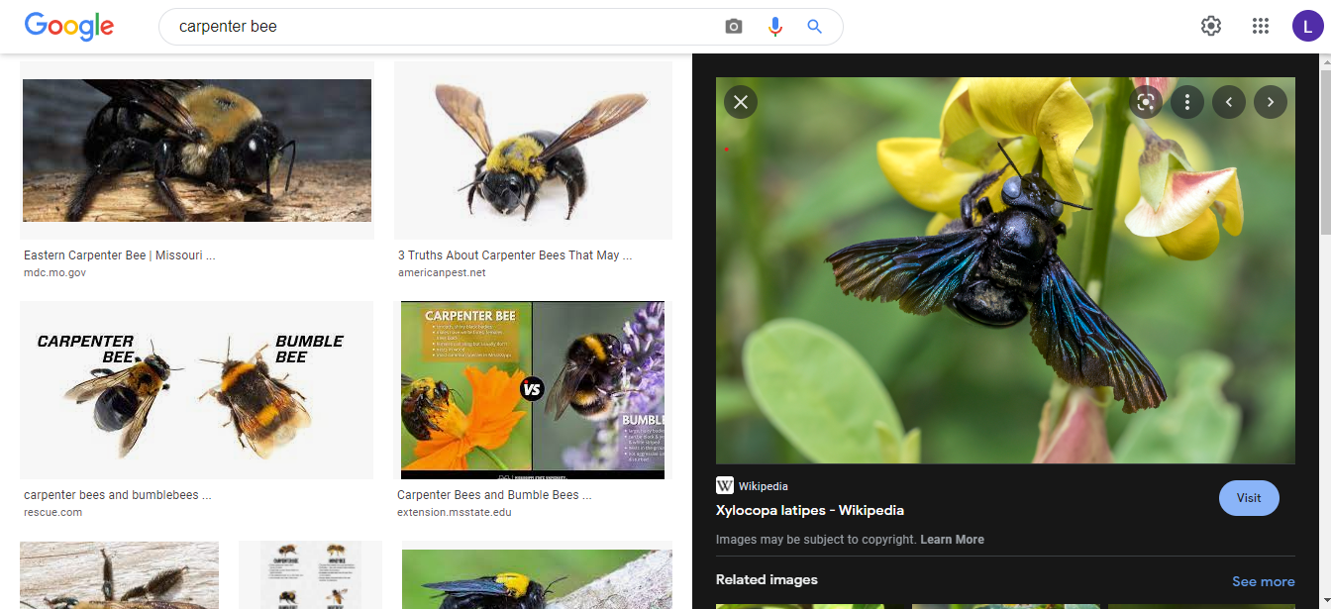
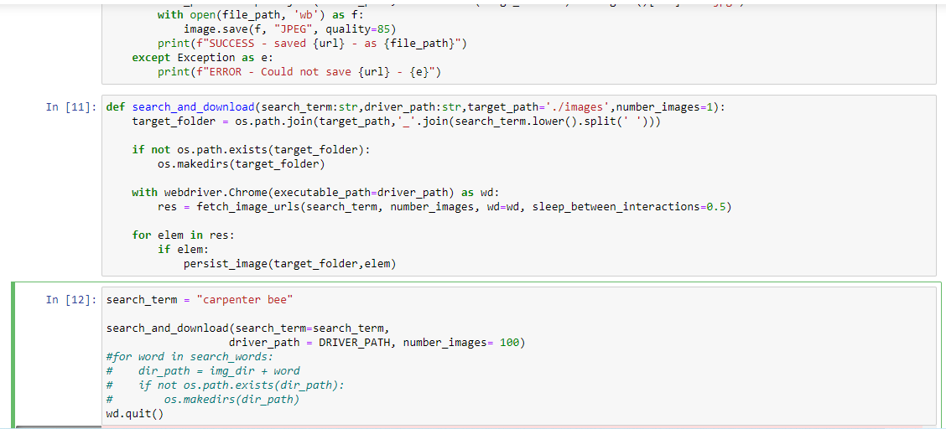
Data Collection
Tasked with gathering 1000 carpenter bee images
Web scraped bee images using python
Used selenium’s Chrome Driver
Notes:
I was tasked with gathering 1000 images of carpenter bees
Gather about 1500 because I knew I would have to remove duplicates
I used python web scraping to collect the images.
The python script searched Google and automatically downloaded image then
went to download the next image.
The script was done using the Chrome drive in the selenium package.
Saved lots of time rather then downloading the images manually
Was the most interesting part of the project because we
used python to automatically download images straight from Google.

Slide 3
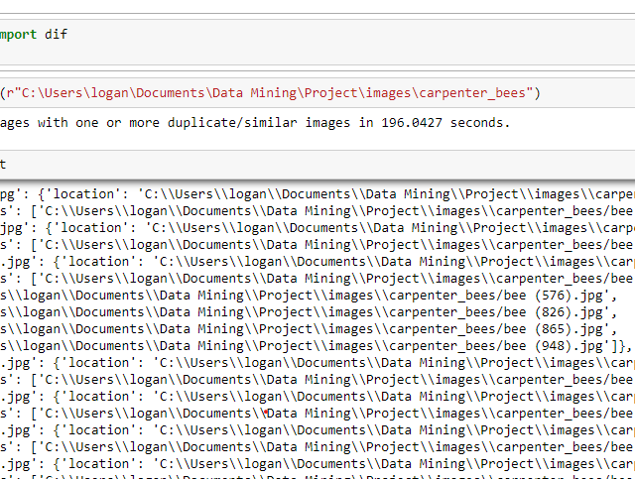
Data Cleaning
Ran a script to detect then delete duplicate images
Removed 375 duplicates
Manually removed unfit images
Notes:
Throughout the process of web scraping, the script downloaded duplicate images.
I ran another script to detect then remove duplicates. It removed 375 duplicates.
After, went in and manually removed images that I thought were unfit.
Such as cartoons, unclear images, or images that didn’t contain a bee.

Slide 4
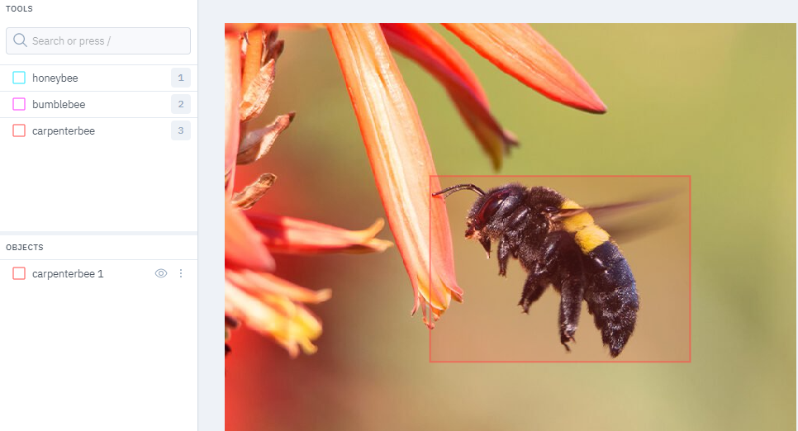
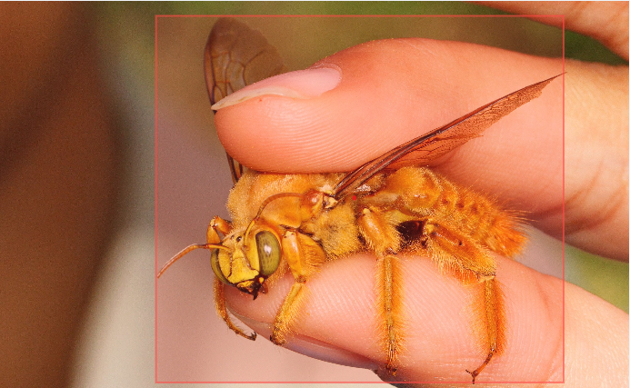
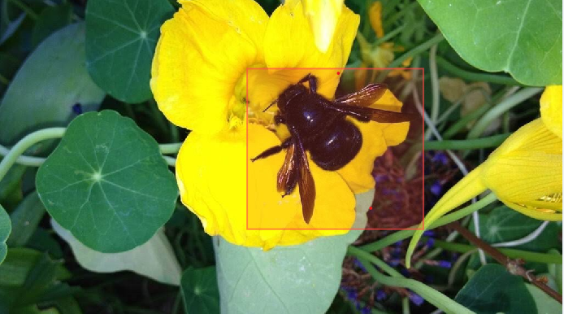
Data Labeling
LabelBox allowed us to manually identity bee type and location in each image
Tedious and time-consuming process
Notes:
Next, I labeled the data using labelbox.
Had to manually look at each of the image and find and label the bees in each of the 1000 images.
Took a lot of time because I had to identifying the bee then box it for each and every image.
It took about 7 hours. Just to label the data.

Slide 5
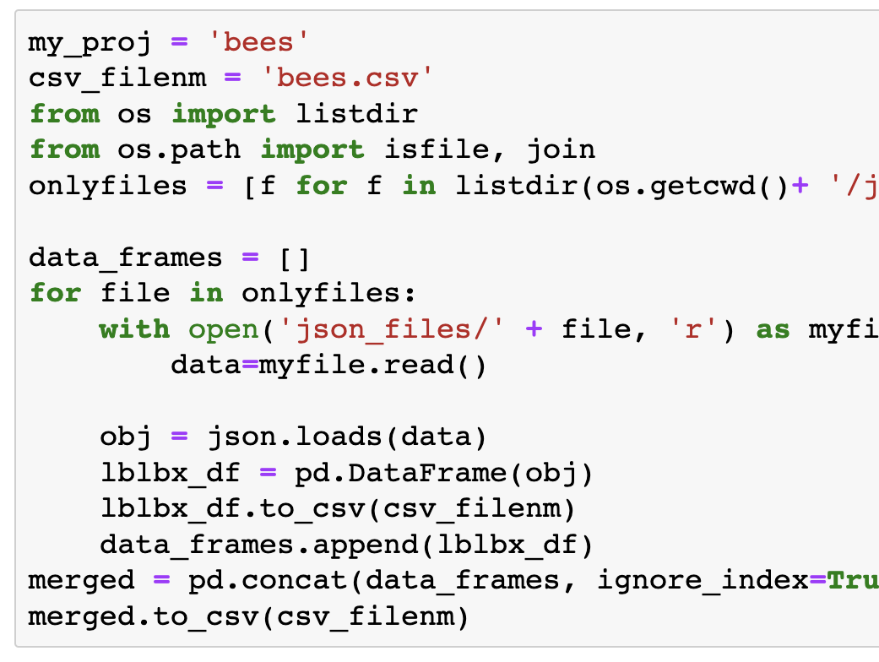
Data Merging
I focused on carpenter bee images
Haleigh focused on honeybee images
Hannah focused on bumble bee images
Combined data using python
to train
Notes:
Each of us were in charge of gather, cleaning, and labeling one type of bee.
I focused on gathering carpenter bee images,
Haleigh focused on gathering honeybee images,
And Hannah focused on gathering bumble bee images.
Once we were done we combined the data.
Explaining how we merged the data.
We each had json structures containing our data, and we combined each structure into a single csv file

Slide 6
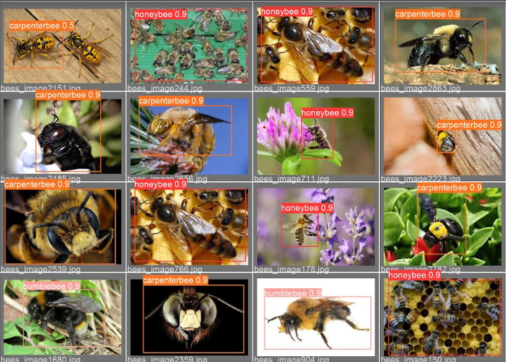
Neural Network Training
Split the data into a training and test set in python
Trained model in Colab
200 epochs
500 epochs
Notes:
To train the Neral Network model we split the data into 80% training data and 20% test data.
We trained the model using Google Colab.
Training the model actually took awhile but it would ran by itself, I just had to check on it every once in a while.
Initially I trained 200 epochs, but it wasn’t enough so I bumped it up to 500.
I also started training a model with 600 epoch with large weights, but I decided to scrap it because it was taking way too long.
This part was the Most challenging of the project.
Because we had to get the boxes from labelbox and converting them to a way colab could read them.
The coordinates of the boxes were in a json structure.
Had to parse out the coordinates, and convert them into coordinates colab could read.
Then we put the adjusted coordinates into a text file and uploaded it to Colab.

Slide 7
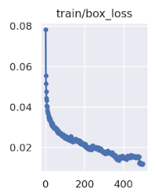
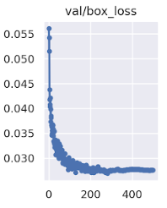
Model Evaluation
Training loss
Still decreasing
Possibly leveled off at ~400
Validation loss
Leveled off at ~300
Increasing after 300
Overfitting
Validation increasing while training decreasing
Notes:
Looking at the losses of the model.
The training loss is decreasing meaning the model is improving.
Starts to kinda level off at about 400 epochs.
The validation loss decreased rapidly, it levels off at around 300 epochs, then starts to increase.
If the training loss is decreasing or flatting out, while the validation is increasing.
This means the model is overfitting to the training data.

Slide 8
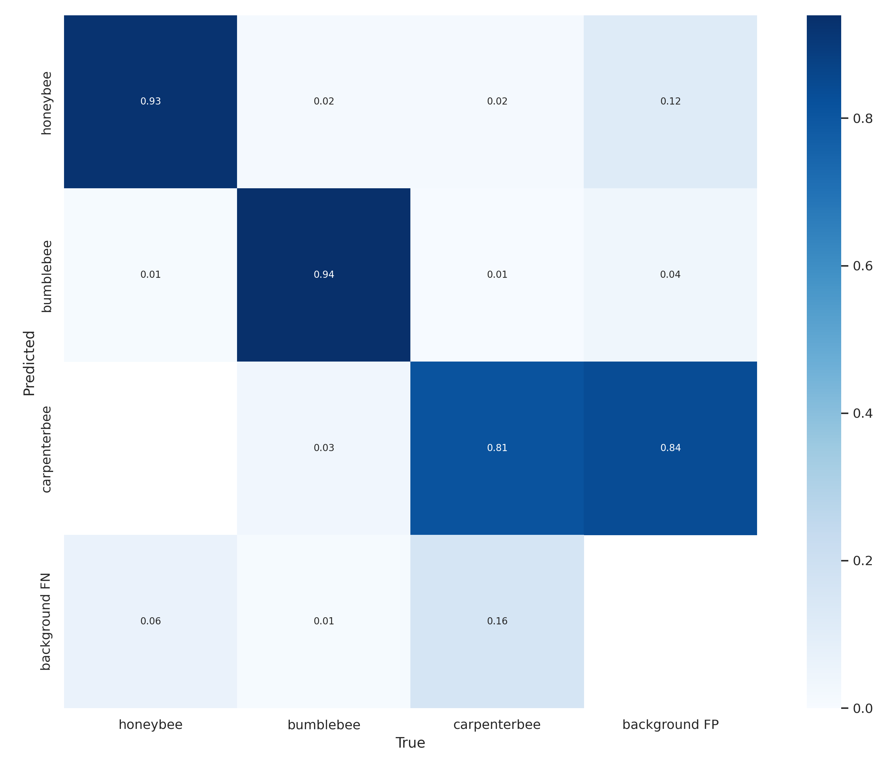
Confusion Matrix
High True Positive
Honeybee
Bumble Bee
High False Positive
Carpenter Bee
Notes:
Looking at the confusion matrix tells us some interesting things.
Honeybee and bumblebee high true positive.
Meaning the model predicted the bee type and it was the correct bee 90% of the time.
Carpenter Bee had a high false positive.
Meaning the model predicted a carpenter bee but was actually just the background.
Since I was in charge of gather carpenter bee data I could tell you most likely why this happened.
The data I gathered had lots of different types of carpenter bees.
Some were the typical black, some were all yellow, some were blue, some were even purple.
With multiple different colors this made it hard for model to distinguish between bee and background.
One thing that was interesting was the false negative for carpenter bees was not real high.
Meaning the model didn’t predict background to be a carpenterbee.
This tells us the model was more likely to say it detected a bee when it did not rather than not detect a bee at all.

Slide 9
Website Demonstration
Created website to highlight model
User inputs bee image into website
Results are displayed in website
http://172.16.128.3:12345/#
Notes:
Once we had finished the model we created a website with the model built in.
A user can upload an image of a bee into the website and the website will spit out a result.
Results are displayed directly in the website
Lets take a look at the website.
Go over website.
Section that goes into detail about the neural network model.
Section with a description of each of the bees.
Footer with everyone in the class.
If we upload a picture of a bee the model should predict what type of bee it is and tell us how confident it is.

